Slide 1
Flight Delay Prediction
Sarah Mansoor, Albert Yu, Meet Kothari
Notes:
Sarah

Slide 2
Agenda
1
2
3
4
Business Problem
Analysis
Results
Recommendations
Notes:
Sarah

Slide 3
1 Business Problem
Notes:
Meet

Slide 4
Business Problem
20-25K flights delayed
Due to many factors such as bad weather, technical issues, air and ground congestion etc.
Airlines lose $
Airline companies incur huge losses due to flight delays
Factors which have an impact on delays
Finding which factors have a significant impacts will lead to a start in a solution for the airline industry
Notes:
Meet

Slide 5
2 Analysis
Notes:
Sarah

Slide 6
Analysis
1
3
4
5
2
Exploratory Analysis
Logistic Regression
Regression Tree
Support Vector Machine
Linear Regression
Notes:
Sarah

Slide 7
3 Results
Notes:
Sarah

Slide 8
Exploratory Analysis
Notes:
Sarah

Slide 9
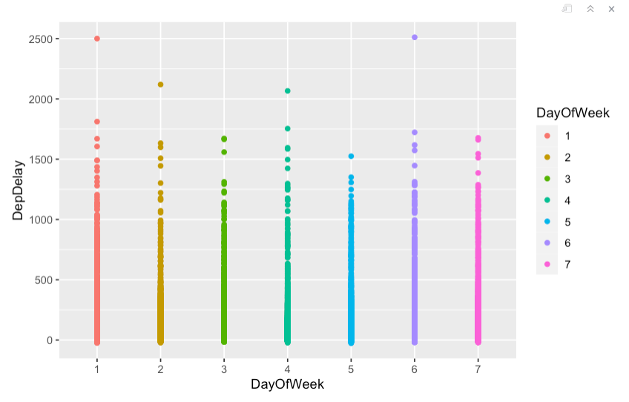
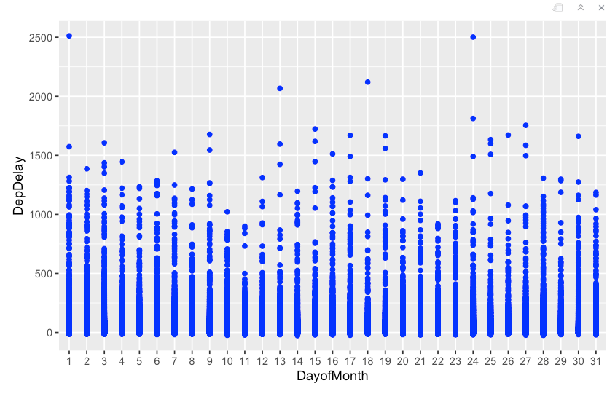
Departure Delay Time By Day of Month and Day of Week
Notes:
Sarah
When we look at the amount of flight delay time by day of the month, we can see the
increased number of flights during the middle of the week, as well as other factors such as
weather conditions and airport congestion. However, without further
information and data, it is not possible to accurately determine the reasons for the observed
pattern in flight delay times.
It is important to carefully analyze all relevant data and consider a
variety of potential factors to accurately understand and predict flight delays which we will do
using machine learning models.
Next, if we look at flight delay time by day of week, we can see that Mondays tend to
have higher delay times. It is possible that the higher flight delay times on
Mondays could be due to increased travel on that day due to people traveling back from trips on
Mondays or people traveling for business- and work-related events.

Slide 10
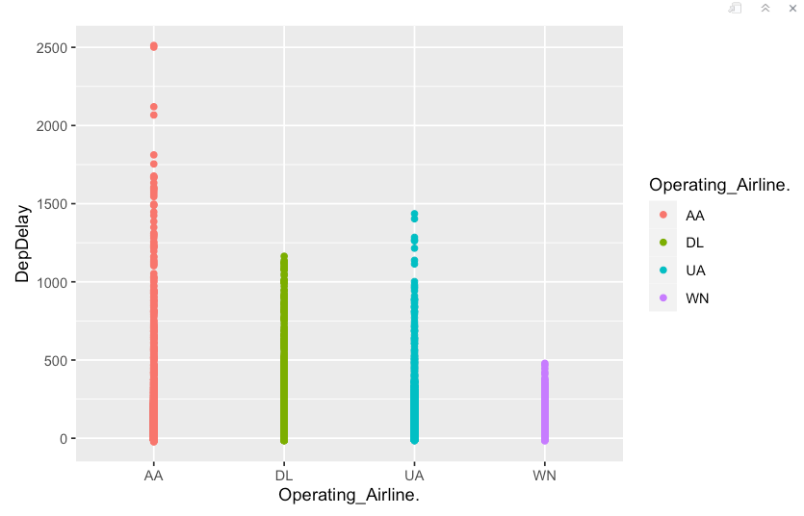
Departure Delay Time By Airline
Notes:
Sarah
American airlines have the highest time for flight delay and United airlines has second
highest time for flight delay time.
Which could be due to the high volume
of flights that these airlines operate, which can lead to more opportunities for delays.
Additionally, these airlines may have a larger number of flights to and from busy airports, which
can also contribute to delays.
Southwest airlines have the lowest flight delay time which could
be due to efficiency of the airline's operations, the routes it operates, and the types of aircraft it
uses. Southwest Airlines has a reputation for being one of the most efficient airlines in the
industry, with a focus on on-time performance and customer satisfaction. Southwest Airlines
also primarily uses Boeing 737 aircraft, which are known for their reliability and efficiency.

Slide 11
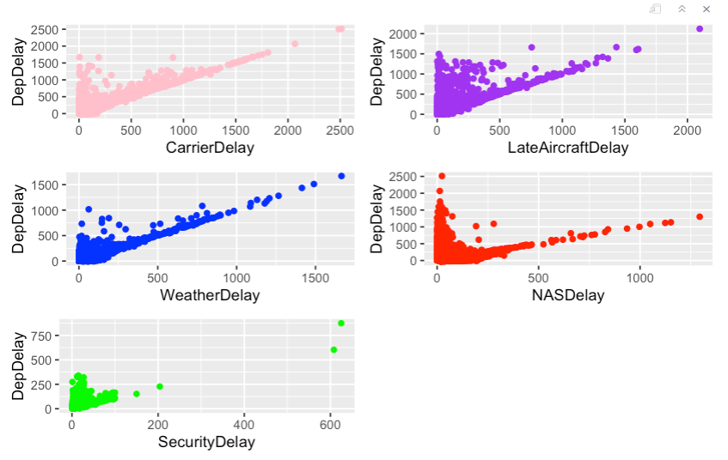
Departure Delay Time by Type of Delay
Notes:
Sarah
In our exploratory analysis of the relationship between delay types and delay time, we
found that carrier delay had the highest range of values for departure delay time, followed by late
aircraft delay. We found that the relationship between delay types and
delay time was strongly positive, with most of the data points falling within the range of less than
500 minutes for each delay type. This indicates that other factors, in addition to the specific delay
type, can affect the total delay time. Furthermore, we observed that when the weather delay time
was above 1000 minutes, the total delay time was around 1400 minutes. This suggests that
weather delay time has a stronger influence on total delay time than NAS delay time, which had
a smaller impact on total delay time. These findings provide valuable insights into the factors
that contribute to flight delay times and can be used to develop strategies for improving flight
performance.

Slide 12
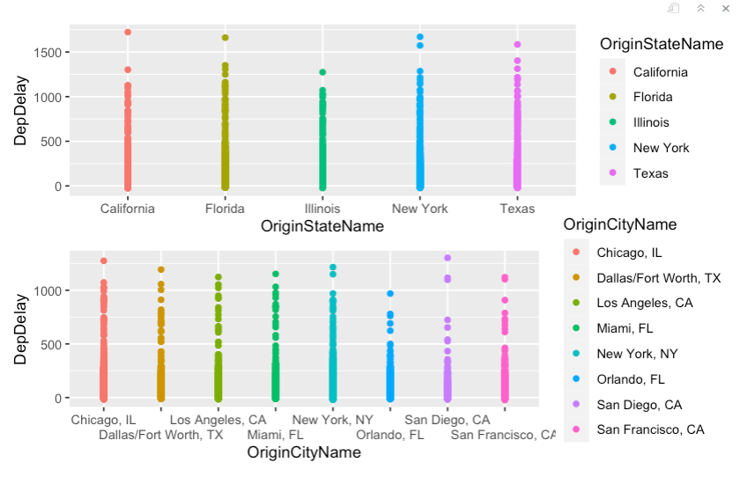
Departure Delay Time by Origin State and City
Notes:
Sarah
When we analyze departure delay times by state, we found that Texas and Florida had the
highest range of values, indicating that flights departing from these states are more likely to
experience delays.
New York and California also had high ranges of
values, but they were lower than those of Texas and Florida. Additionally, both New York and
California had some outlier data points with total delay times above 1500 minutes. In contrast,
Illinois had the lowest range of values for departure delay times, indicating that flights departing
from this state are less likely to be delayed. These findings suggest that the state of origin can
have a significant impact on flight delay times and can be useful for identifying potential issues
and developing strategies to improve flight performance.
When we analyze which cities have the highest delay times, we found that Chicago,
Dallas, and New York City were the top three.
This is interesting because,
while Illinois had the lowest range of values for the whole state, Chicago had the highest range
of values for any individual city. This may suggest that Chicago is a particularly busy city with a
high volume of air traffic, while the rest of the state is less busy. On the other hand, when we
looked at the states of Texas, New York, Florida, and California, we found that they all had
multiple cities with high ranges of values for delay time. This indicates that these states are
generally busy with a high volume of air traffic, which can contribute to delays.

Slide 13
Linear Regression
Notes:
Meet

Slide 14
Linear Regression - Departure Delay Time
Flights from Dallas TX, Los Angeles CA, New York NY, Orlando FL, and San Francisco CA were found to be the most significant in terms of P-value.
The 18th of the month was found to be the day with the most delays which could be due to increased travel demand, severe weather conditions, and increased airport congestion.
Factors such as taxi in, taxi out, wheels off, wheels on, distance of the flight, and the types of delays were found to be significant in the model.
The model had a high R-squared value of 0.985, indicating that it was highly accurate in predicting flight delays.
Notes:
Meet
According to the analysis of a linear regression model, flights from Dallas TX, Los
Angeles CA, New York NY, Orlando FL, and San Francisco CA were found to be the most
significant in terms of P-value.
This is likely because these cities are home
to some of the busiest airports in the United States and have a high frequency of flights. United
Airlines and Southwest Airlines were also identified as significant factors in flight delays.
The 18th of each month was found to be the day with the most delays which could be due to
increased travel demand, severe weather conditions, and increased airport congestion. It is
possible that the 18th falls at a time when many people are planning to travel for the weekend,
leading to an increase in flights and potential delays. It is important to note that the specific
reasons for the higher number of delays on the 18th of each month can vary and further
analysis would be needed to determine the exact causes.
factors such as taxi in, taxi out, wheels off, wheels on, distance of the flight, and the types of delays mentioned in our
explanatory analysis were found to be significant in the model.
The model had a high R-squared value of 0.985, indicating that it was highly accurate in predicting flight delays.

Slide 15
Logistic Regression
Notes:
Albert

Slide 16
Logistic Regression: More than 3 Hour Delay
Step function to identify the significant features that increase the likelihood of a flight being delayed by more than 3 hours
Significant features: operating airline Delta, taxi in and out times, carrier delay, weather delay, NAS delay, and late aircraft delay.
Flights from Delta Airline are more likely to be delayed more than 3 hours
The model's null deviance had a value of 3122.77 with 8303 df, and the residual deviance had a value of 135.58 with 8294 df
The Chi-Square test was applied to the model, resulting in a p-value that was much less than 0.05. This indicates that the model is highly effective in predicting the probability of a flight being delayed.
Notes:
Albert
In the logistics regression model, we used a step function to identify the significant
features that increase the likelihood of a flight being delayed by more than 3 hours.
This time frame was chosen because airlines are often required to compensate
passengers if the flight is delayed by more than 3 hours.
By analyzing these significant features,
we can better understand which factors are most likely to lead to long flight delays and how they
can be addressed to improve flight performance.
This information can be useful for airlines and
airport operators to manage their operations and for passengers to plan their travel accordingly.
It can also help identify potential issues and inefficiencies in the aviation industry and guide
efforts to address them.
These features were found to be the operating airline Delta, taxi in and
out times, carrier delay, weather delay, NAS delay, and late aircraft delay. In summary, flights
from Delta Airline are more likely to be delayed.
Additionally, having any of the identified types
of delays increases the likelihood of a flight being delayed.
The model's null deviance had a
value of 3122.77 with 8303 degrees of freedom, and the residual deviance had a value of
135.58 with 8294 degrees of freedom.
The Chi-Square test was applied to the model, resulting
in a p-value that was much less than 0.05. This indicates that the model is highly effective in
predicting the probability of a flight being delayed.

Slide 17
Regression Tree
Notes:
Albert

Slide 18
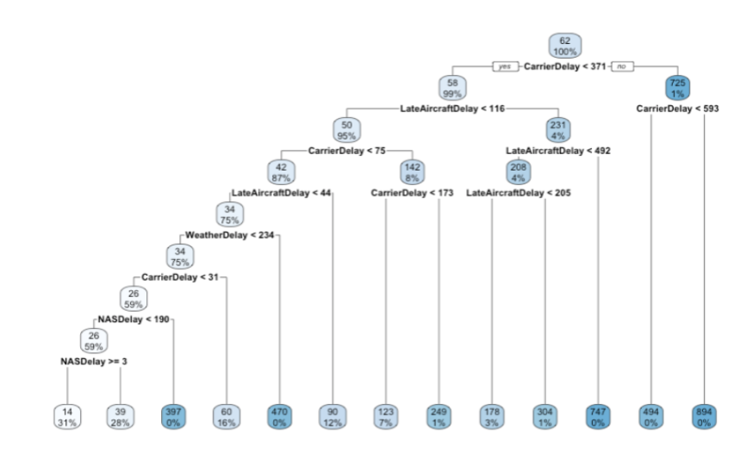
Regression Tree - Departure Delay Time
Notes:
Albert
Each terminal node shows the predicted delay time for flights in that node, along with the number of observations from the original dataset that belong to that node.
The regression tree model partitions the data into 13 parts, and the expected delay time for each part is estimated by the average delay time in that part.
There were 3% of the flights from the dataset with carrier delay less than 371 minutes and late aircraft delay between 116 and 205 minutes, and their average delay was 178 minutes. The regression tree model can be used to identify which factors are most influential in determining flight delay times.
For example, the model may show that flights with a long distance or flights that operate during busy periods at the airport are more likely to be delayed. This information can be useful for airlines and airport operators to identify potential issues and take steps to address them.
For example, an airline may decide to adjust its flight schedules or use faster aircraft on long-distance flights to reduce the likelihood of delays.
Additionally, the regression tree model can help to identify patterns and trends in flight delay times. For example, the model may show that flights from certain cities or operated by certain airlines are more likely to be delayed at certain times of day or on certain days of the week.
This information can be used to develop strategies for mitigating delays and improving the overall performance of the aviation industry.
Overall, the regression tree model is a powerful tool for understanding and predicting flight delay times. By applying this model, airlines and airport operators can make informed decisions to improve the performance of their operations and provide a better experience for passengers.

Slide 19
Support Vector Machine
Notes:
Meet

Slide 20
SVM - Departure Delay Time
The following independent factors were used to predict flight delay time: taxi in and out times, wheels on and off times, arrival time, arrival delay, distance, carrier delay, weather delay, NAS delay, security delay, and late aircraft delay.
The accuracy of this model was around 93.64% with sensitivity at 93.59% and specificity at 1. This was achieved by changing the threshold from 0.5 to 0.45, which increased the accuracy of the model without significantly impacting the overall accuracy.
When the threshold was changed to 0.3, the accuracy and sensitivity improved even further, reaching 94.17% and 94.09%, respectively. The specificity remained unchanged.
Notes:
Meet
In the SVM model, the following independent factors were used to predict flight delay
time: taxi in and out times, wheels on and off times, arrival time, arrival delay, distance, carrier
delay, weather delay, NAS delay, security delay, and late aircraft delay.
The accuracy of this
model was around 93.64% with sensitivity at 93.59% and specificity at 1. This was achieved by
changing the threshold from 0.5 to 0.45, which increased the accuracy of the model without
significantly impacting the overall accuracy.
When the threshold was changed to 0.3, the
accuracy and sensitivity improved even further, reaching 94.17% and 94.09%, respectively. The
specificity remained unchanged.
These results indicate that changing the threshold can improve
the accuracy and sensitivity of the SVM model, and further optimization may be possible by
adjusting the threshold value.

Slide 21
4 Recommendations
Notes:
Sarah

Slide 22
Recommendations
Investing in technology and infrastructure to improve air traffic management and reduce congestion at airports.
Working with meteorologists and weather forecasters to develop strategies for dealing with adverse weather conditions.
Collaborating with other airlines and airport operators to share information and resources and coordinate operations to reduce delays.
Providing passengers with timely and accurate information about flight delays and any potential compensation they may be entitled to.
Training pilots and other aviation professionals to handle potential issues that can cause delays, such as technical problems with the aircraft or issues with air traffic control.
Notes:
Sarah
Based on the results of the above models, several factors can affect flight delay times,
including the origin and destination cities, the operating airline, the day and time of the flight,
and various other factors such as weather conditions, airport congestion, and the distance of the
flight. By analyzing these factors, the models were able to make predictions about the likelihood
of flight delays with a high degree of accuracy.
One of the key recommendations that can be derived from these models is the
importance of addressing the factors that are most likely to lead to flight delays. For example,
airlines operating in cities with high volumes of air traffic or at airports with congestion may need
to implement strategies to improve their on-time performance. Airlines may need to consider the
specific routes and times of day that are most susceptible to delays and take steps to mitigate
potential issues.
In addition to the recommendations mentioned above, there are several other steps that
airlines and airport operators can take to minimize flight delays. Some of these steps include:
• Investing in technology and infrastructure to improve air traffic management and reduce
congestion at airports.
• Working with meteorologists and weather forecasters to develop strategies for dealing
with adverse weather conditions.
• Collaborating with other airlines and airport operators to share information and resources
and coordinate operations to reduce delays.
• Providing passengers with timely and accurate information about flight delays and any
potential compensation they may be entitled to.
• Training pilots and other aviation professionals to handle potential issues that can cause
delays, such as technical problems with the aircraft or issues with air traffic control.
By implementing these and other measures, airlines and airport operators can help to
reduce the number of flight delays and improve the overall performance of the aviation
industry. This can benefit passengers by providing them with a better travel experience,
and it can also help airlines and airports to save time and money and improve their
reputations.
Overall, the results of these models highlight the potential value of using machine learning
techniques to predict and manage flight delays. By applying these techniques, airlines and
airport operators can better understand the factors that affect flight performance and take action
to improve it. This can help to enhance the customer experience, improve operational efficiency,
and reduce the costs and disruptions associated with flight delays

Slide 23
Thank you for joining us on-board
Notes:
thank you for joining us on this trip and we are looking forward to seeing you on board again in the near future.

